Slide 1
Friday

Slide 2
Course Logistics
Problem Set 1 – Due Wednesday, February 8
Weekly Activity – Jupyter Notebook uploaded – submit Notebook on Canvas
Project Milestone 1 – Due Friday, Feb. 3 – Today!

Slide 3
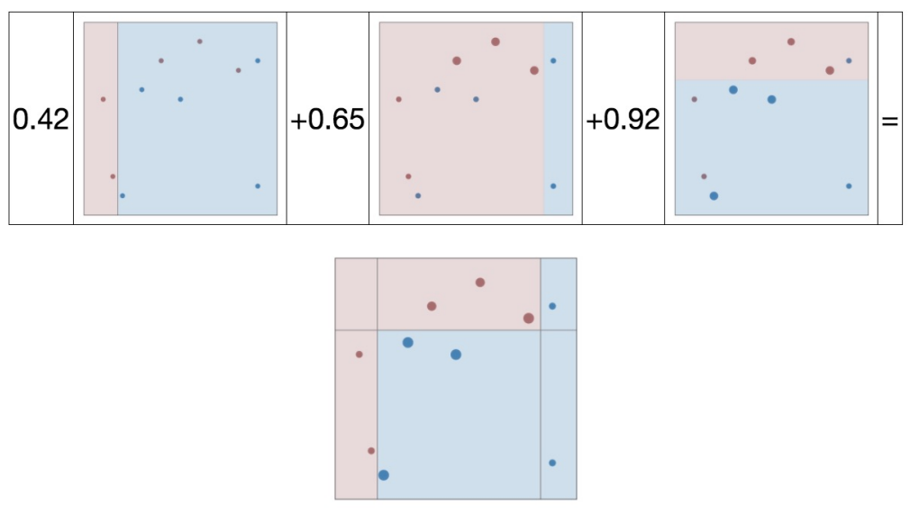
Adaboost – Working Example
Final Ensemble Model

Slide 4
Boosting – Benefits (W.R.T. a single tree)
Reducing the variance?
Variance – Sensitivity to the training set
Reducing the bias?
Bias – Sensitivity to the model

Slide 5
Boosting – Benefits (W.R.T. a single tree)
Reducing the variance?
Variance – Sensitivity to the training set
A single tree can overfit to a single sample, creating an overly generalize branch that captures a section around an outlier.
Reducing the bias?
Bias – Sensitivity to the model
A single tree will deterministically choose the same features in the same order.

Slide 6
Boosting - Benefits
Reducing the variance
Variance – Sensitivity to the training set
Yes
Reducing the bias
Bias – Sensitivity to the model
Yes

Slide 7
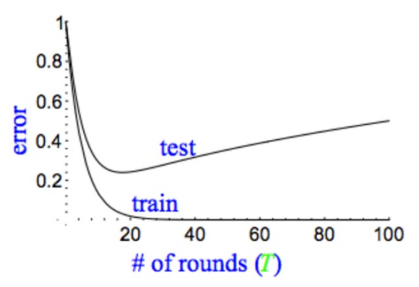
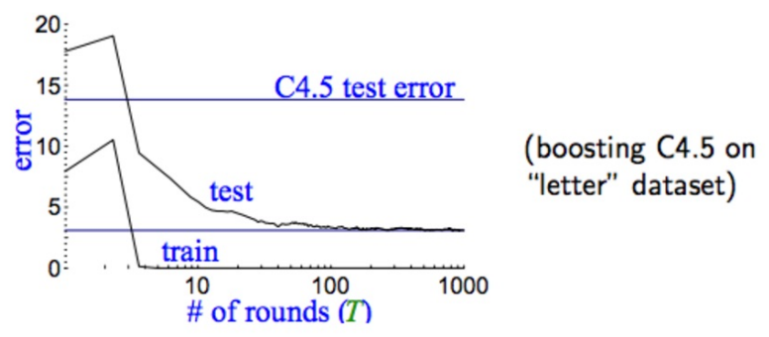
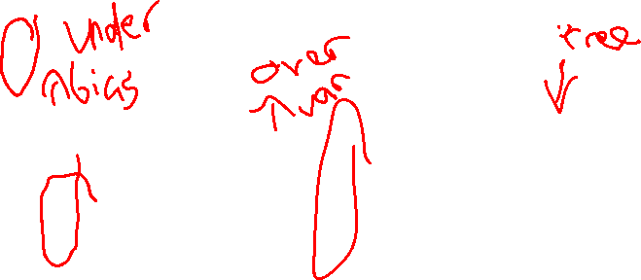
Model Performance
Traditional Models
Boosted Models

Slide 8
Benefits of Boosting
Fast
Easy to Train
Little tuning (K)
Algorithmically, Weak-classifier Independent
No matter what classifier we use, we can run Boosting
We can try boosting on a variety of weak classifiers

Slide 9
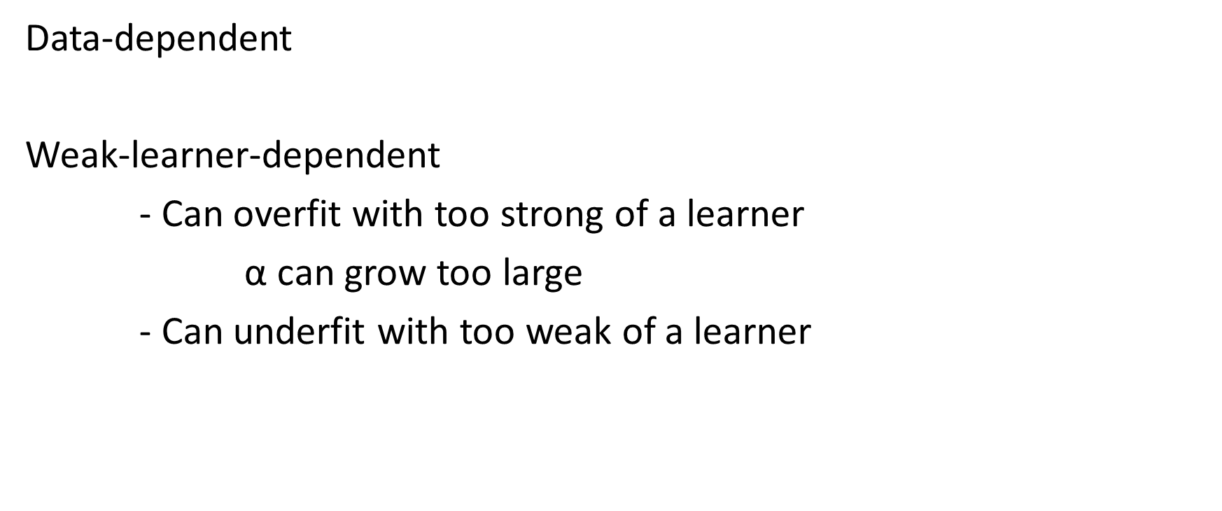
Boosting “gotchas”
Data-dependent
Weak-learner-dependent
- Can overfit with too strong of a learner
$\text{α}$ can grow too large
- Can underfit with too weak of a learner

Slide 10
More About Errors & Data Partitions

Slide 11
Calculating Errors
Error = 1/n * ∑_{i=1→n}(I(ŷ_{i} ≠ y_{i}))
# errors / # instances

Slide 12
Calculating Errors
Error = 1/n * ∑_{i=1→n}(I(ŷ_{i} ≠ y_{i}))
# errors / # instances
Is this always helpful? Meaningful?

Slide 13
Errors
Skewed Classes
- Classifying a day of sun in Yuma, AZ (308 sunny days / year)
my classifier - isSunny = true

Slide 14
Errors
Skewed Classes
- Classifying a day of sun in Yuma, AZ (308 sunny days / year)
my classifier - isSunny = true
84 % Accuracy
- What if it’s a case with 98% in one class?
Is 98.5% accuracy helpful?

Slide 15
Errors
Skewed Classes
- Classifying a day of sun in Yuma, AZ (308 sunny days / year)
my classifier - isSunny = true
84 % Accuracy
- What if it’s a case with 98% in one class?
Is 98.5% accuracy helpful?
Are all errors created equal?

Slide 16
Types of Errors
Predicted Positive Rate (Precision) = Hits / (Hits + False Alarm)
Classified As Ground Truth | C | ~C
C | True Positive (Hit) | False Negative (Miss)
~C | False Positive (False Alarm) | True Negative (Correct Rejection)

Slide 17
Types of Errors
Predicted Negative Rate (Negative Predictive Value) = Corr. Rej / (Miss + Corr. Rej.)
Classified As Ground Truth | C | ~C
C | True Positive (Hit) | False Negative (Miss)
~C | False Positive (False Alarm) | True Negative (Correct Rejection)

Slide 18
Types of Errors
True Positive Rate (Sensitivity, Recall) = Hits / (Hits + Miss)
Classified As Ground Truth | C | ~C
C | True Positive (Hit) | False Negative (Miss)
~C | False Positive (False Alarm) | True Negative (Correct Rejection)

Slide 19
Types of Errors
1 - False Positive Rate (Specificity) = Corr. Rej. / (False Alarm + Corr. Rej.)
Classified As Ground Truth | C | ~C
C | True Positive (Hit) | False Negative (Miss)
~C | False Positive (False Alarm) | True Negative (Correct Rejection)

Slide 20
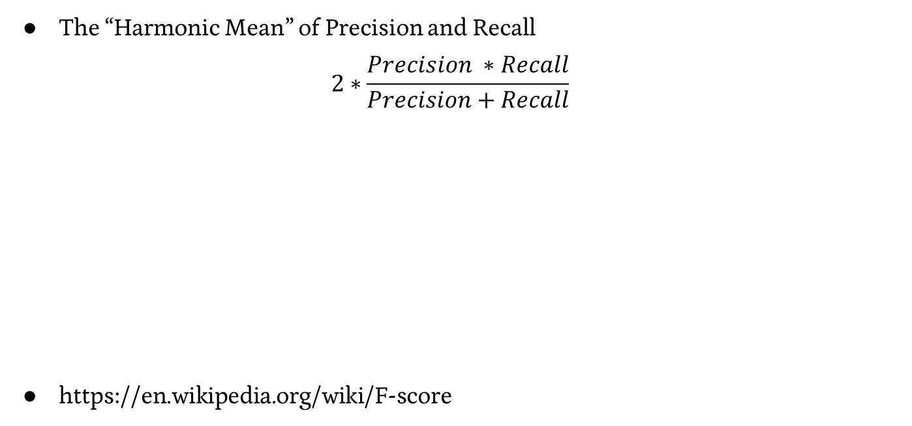
Errors – F1 Score
The “Harmonic Mean” of Precision and Recall
$$2∗\frac{Precision ∗Recall}{Precision+Recall}$$
https://en.wikipedia.org/wiki/F-score

Slide 21
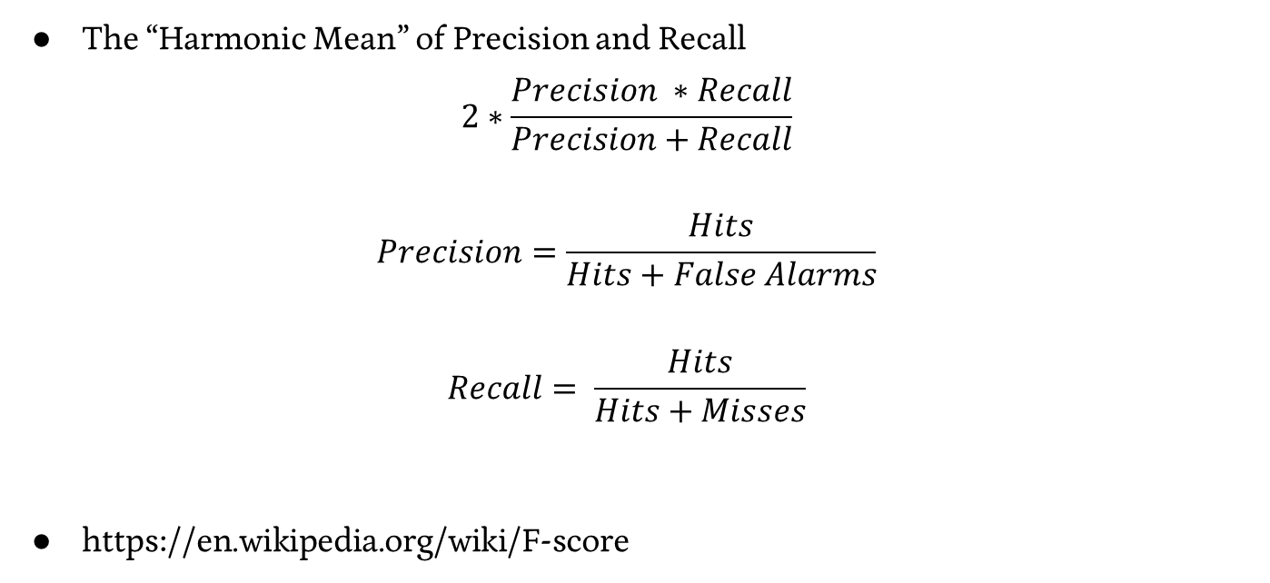
Errors – F1 Score
The “Harmonic Mean” of Precision and Recall
$$2∗\frac{Precision ∗Recall}{Precision+Recall}$$
$$Precision=\frac{Hits}{Hits+False Alarms}$$
$$Recall= \frac{Hits}{Hits+Misses}$$
https://en.wikipedia.org/wiki/F-score

Slide 22
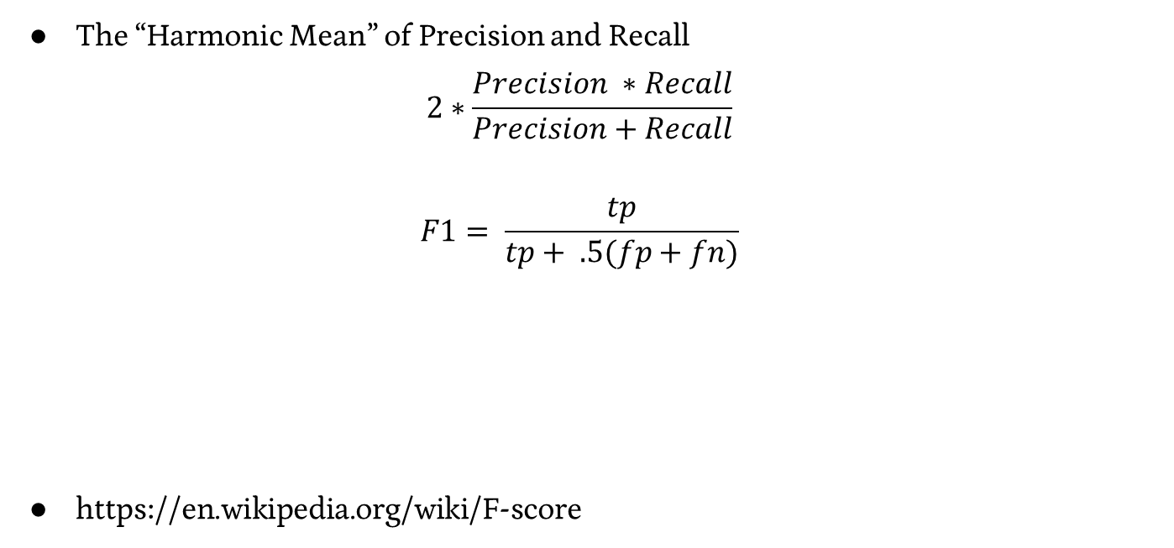
Errors – F1 Score
The “Harmonic Mean” of Precision and Recall
$$2∗\frac{Precision ∗Recall}{Precision+Recall}$$
$$F1= \frac{tp}{tp+ .5(fp+fn)}$$
https://en.wikipedia.org/wiki/F-score

Slide 23
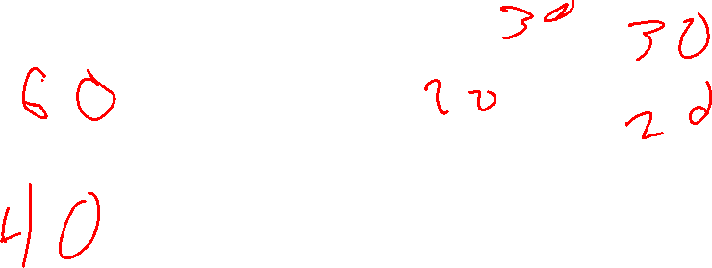
Training & Hold-Out & Test Sets
Train Data
Validation Data
I pull out another random 20% of my data
If my dataset is smaller, I’m starting to run out of data… Continued!
Test Data

Slide 24

What’s in a test set?
Suddenly, you’ve got very little data with which to train

Slide 25
K-Fold Cross Validation
Create “folds” of your data, or K equal size groups
Training Data

Slide 26
K-Fold Cross Validation
Create “folds” of your data, or K equal size groups
Training Data
80%
Fold 1
Fold 2
Fold 3
Fold 4
Fold 5

Slide 27
K-Fold Cross Validation
Iterate through making each fold the validation set once
Accuracy = 11 / 20
Training Data
80%
Fold 1
Fold 2
Fold 3
Fold 4
Fold 5

Slide 28
K-Fold Cross Validation
Iterate through making each fold the validation set once
Accuracy = 17 / 20
Training Data
80%
Fold 1
Fold 2
Fold 3
Fold 4
Fold 5

Slide 29
K-Fold Cross Validation
Iterate through making each fold the validation set once
Accuracy = 16 / 20
Training Data
80%
Fold 1
Fold 2
Fold 3
Fold 4
Fold 5

Slide 30
K-Fold Cross Validation
Iterate through making each fold the validation set once
Accuracy = 13 / 20
Training Data
80%
Fold 1
Fold 2
Fold 3
Fold 4
Fold 5

Slide 31
K-Fold Cross Validation
Iterate through making each fold the validation set once
Accuracy = 16 / 20
Training Data
80%
Fold 1
Fold 2
Fold 3
Fold 4
Fold 5

Slide 32
K-Fold Cross Validation
Iterate through making each fold the validation set once
Trial | Accuracy
1 | 11/20
2 | 17/20
3 | 16/20
4 | 13/20
5 | 16/20

Slide 33
K-Fold Cross Validation
Iterate through making each fold the validation set once
Take the average of errors for each trial as your expected average
Trial | Accuracy
1 | 11/20
2 | 17/20
3 | 16/20
4 | 13/20
5 | 16/20

Slide 34
K-Fold Cross Validation
Iterate through making each fold the validation set once
Take the average of errors for each trial as your expected average
Error = .27, Accuracy = .73
Trial | Accuracy
1 | 11/20
2 | 17/20
3 | 16/20
4 | 13/20
5 | 16/20

Slide 35
K-Fold Cross Validation
Iterate through making each fold the validation set once
Take the average of errors for each trial as your expected average
Error = .27, Accuracy = .73
But do we trust this number?
Trial | Accuracy
1 | 11/20
2 | 17/20
3 | 16/20
4 | 13/20
5 | 16/20

Slide 36
K-Fold Cross Validation
Iterate through making each fold the validation set once
Take the standard error for our trials, 95% Confidence Interval is approximately +/- 2SE
Trial | Accuracy
1 | 11/20
2 | 17/20
3 | 16/20
4 | 13/20
5 | 16/20

Slide 37
K-Fold Cross Validation
Iterate through making each fold the validation set once
Take the standard error for our trials, 95% Confidence Interval is approximately +/- 2SE
2SE = .1, confidence interval = [.17, .37]
Trial | Accuracy
1 | 11/20
2 | 17/20
3 | 16/20
4 | 13/20
5 | 16/20

Slide 38
K in K-Fold Cross Validation
It Depends…
K = 5 or K = 10 are popular, but it also depends on your dataset size
People will do multiple rotations / bootstrapping as well.

Slide 39
Deciding More Complex Things

Slide 40
Interlude – Types of Data
Continuous Numeric
- Maps to a “real” number
- Distances between numbers have meaning
Discrete Numeric
- Maps to a discrete, finite (e.g. bins) or infinite set (e.g. integers)
- Distances between numbers have meaning
Ordinal
- Entries have an order, but distances lose meaning
Categorical
- Entries are each unique, but don’t have further restrictions

Slide 41
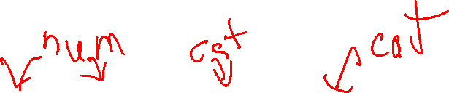
Multi-Class Example - Dogs
Height | Weight | Color | Dog Type
22 in | 62 lbs | Black | Black Lab
15 in | 45 lbs | White, brown | English Bulldog
9 in | 19 lbs | Black | Dachshund

Slide 42
Multi-Class Example - Dogs
Height | Weight | Color | Dog Type
22 in | 62 lbs | Black | Black Lab
15 in | 45 lbs | White, brown | English Bulldog
9 in | 19 lbs | Black | Dachshund
How can a decision tree handle this kind of task?
Multiclass
Mix of Categorical and Numeric

Slide 43
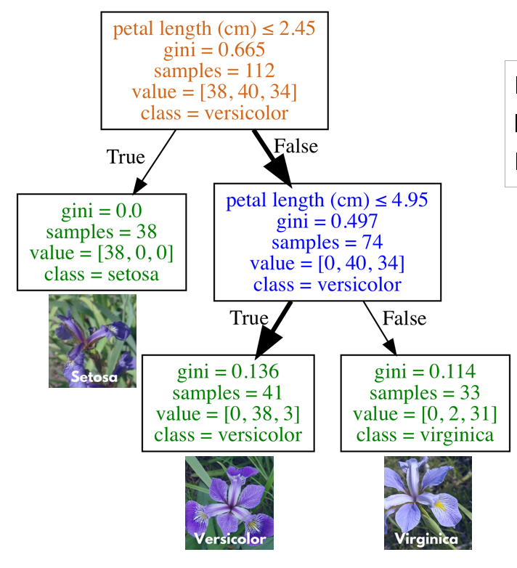
Multi-Class Classification – Decision Trees

Slide 44
Categorical Data – Ways to Encode
Create a new numeric value for each category
White | 1
Brown | 2
Gold | 3
Red | 4

Slide 45
Categorical Data – Ways to Encode
Create a new numeric value for each category
Problems?
White | 1
Brown | 2
Gold | 3
Red | 4

Slide 46

Categorical Data – Ways to Encode
Create a new binary feature (dummy variable) for each category
- one-hot encoding
Color | isWhite | isBrown | isGolden | isRed
White | 1 | 0 | 0 | 0
Golden | 0 | 0 | 1 | 0
Brown | 0 | 1 | 0 | 0
Red | 0 | 0 | 0 | 1

Slide 47
Monday

Slide 48
Course Logistics
Problem Set 1 – Due Wednesday, February 8
Weekly Activity – Jupyter Notebook uploaded – submit Notebook on Canvas
Project Milestone 2 – Due Friday, Feb. 17
Groups are not set up yet (9AM Monday), but hopefully should be up ASAP. Submissions will work by grouping – we’ll look at that once groups are set.

Slide 49
Sidebar – Training, Validation, Testing sets
1) Training Set – used in the (usually iterative) training process
2) Validation Set – kept out of the training process, used to meter your training process
3) Testing Set – Used to evaluate the accuracy, etc. of your learning

Slide 50
Optimizing K using a Validation Set
Valid-ation Data
You’ve used the Train and Validation data a lot…
It’s not very clean to report your “validation” accuracy, because you worked hard finding the K (hyperparameter) that was the very best. That’s “cheating” (from a success perspective, not from a class perspective).
You need a Test dataset that is untouched to see how good your final model really does.
This is what you would report to others as the expected goodness of your model.
Train Data
Test Data

Slide 51
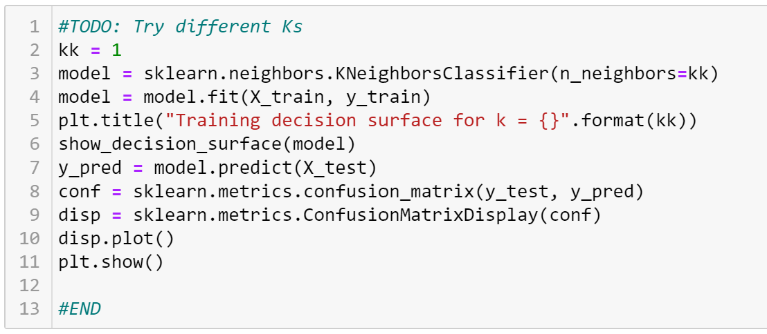
Train vs. Test (or Valid)

Slide 52
Deciding More Complex Things

Slide 53
Interlude – Types of Data
Continuous Numeric
- Maps to a “real” number
- Distances between numbers have meaning
Discrete Numeric
- Maps to a discrete, finite (e.g. bins) or infinite set (e.g. integers)
- Distances between numbers have meaning
Ordinal
- Entries have an order, but distances lose meaning
Categorical
- Entries are each unique, but don’t have further restrictions

Slide 54
Multi-Class Example - Dogs
Height | Weight | Color | Dog Type
22 in | 62 lbs | Black | Black Lab
15 in | 45 lbs | White, brown | English Bulldog
9 in | 19 lbs | Black | Dachshund

Slide 55
Multi-Class Example - Dogs
Height | Weight | Color | Dog Type
22 in | 62 lbs | Black | Black Lab
15 in | 45 lbs | White, brown | English Bulldog
9 in | 19 lbs | Black | Dachshund
How can a decision tree handle this kind of task?
Multiclass
Mix of Categorical and Numeric

Slide 56
Multi-Class Classification – Decision Trees

Slide 57
Categorical Data – Ways to Encode
Create a new numeric value for each category
White | 1
Brown | 2
Gold | 3
Red | 4

Slide 58
Categorical Data – Ways to Encode
Create a new numeric value for each category
Problems?
White | 1
Brown | 2
Gold | 3
Red | 4

Slide 59
Categorical Data – Ways to Encode
Create a new binary feature (dummy variable) for each category
- one-hot encoding
Color | isWhite | isBrown | isGolden | isRed
White | 1 | 0 | 0 | 0
Golden | 0 | 0 | 1 | 0
Brown | 0 | 1 | 0 | 0
Red | 0 | 0 | 0 | 1

Slide 60
Multi-Class Example - Dogs
Height | Weight | Color | Dog Type
22 in | 62 lbs | Black | Black Lab
15 in | 45 lbs | White, brown | English Bulldog
9 in | 19 lbs | Black | Dachshund
How can a KNN handle this kind of task?
Multiclass
Mix of Categorical and Numeric

Slide 61
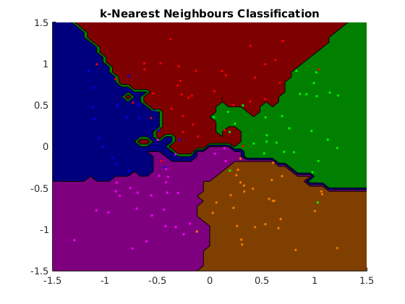
Multi-Class Classification - KNN
Notes:
https://www.cs.ubc.ca/~schmidtm/Software/matLearn/multiclass/demos/html/demo_multiclass_KNN_01.png

Slide 62
How to handle incompatible data?

Slide 63
Feature Engineering

Slide 64
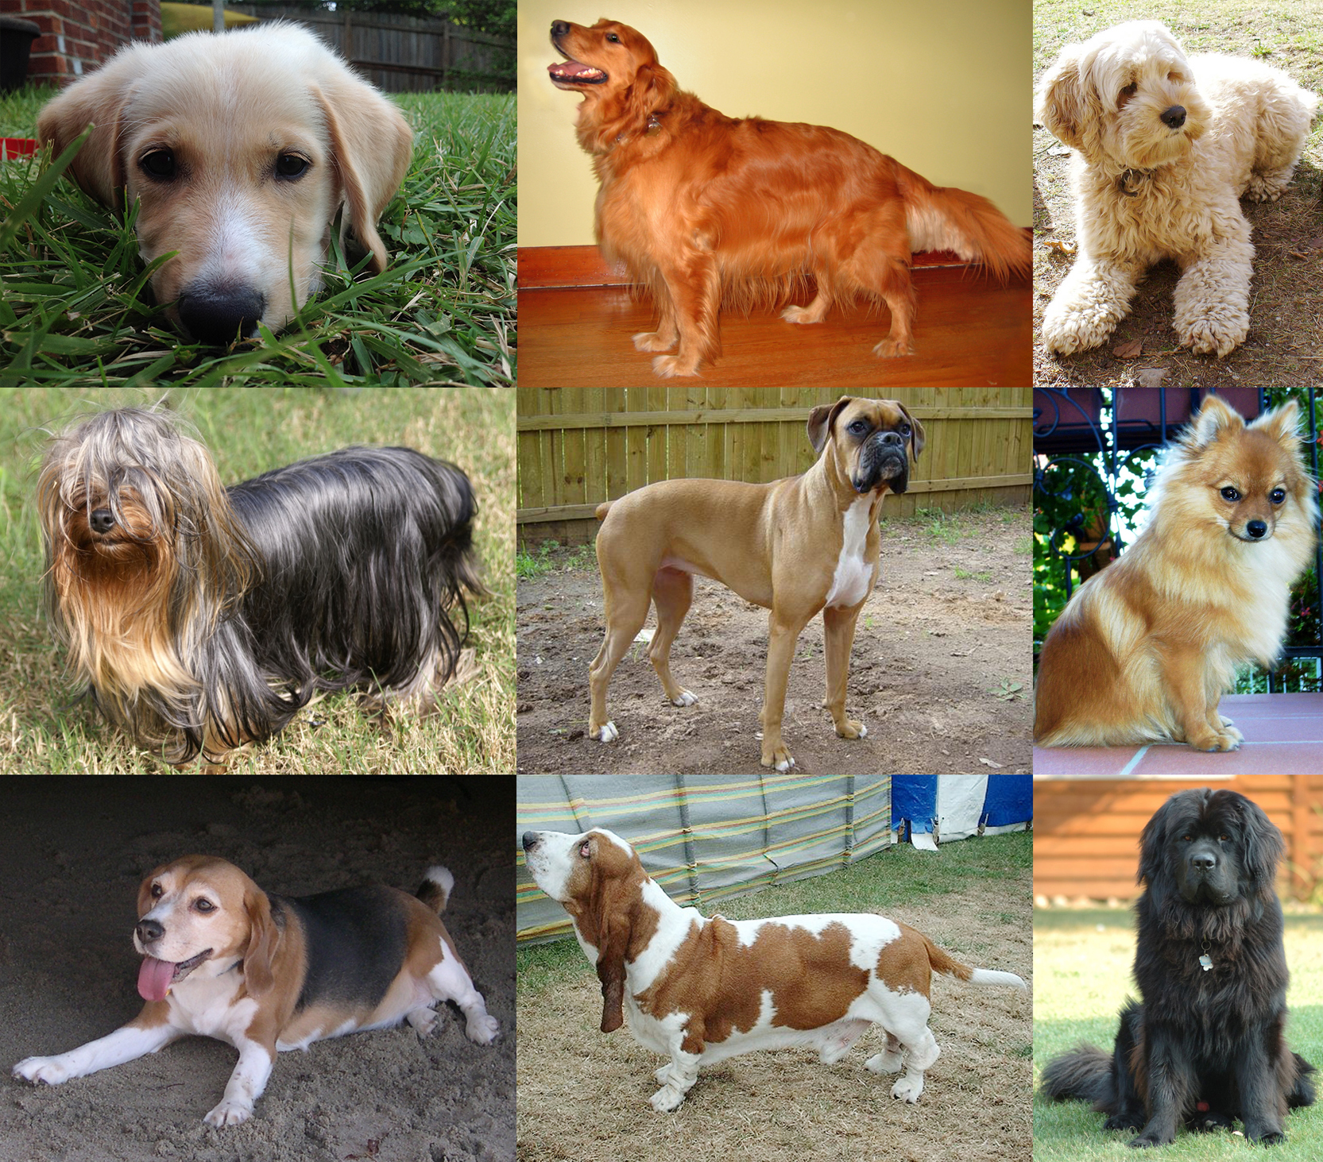
Problems With Data
Categorical Data

Slide 65
Categorical Data – Ways to Encode
Match to a corresponding numeric value
Color → R, G, B values (0 – 256)

Slide 66
Categorical Data – Ways to Encode
Match to a corresponding numeric value
Color → R, G, B values (0 – 256)
Will this work for every type of categorical data?
- choosing a piece of furniture to recommend based on room

Slide 67

“Categorical” Data – Working with Time
Person | Time | isWorking
David | 2/3/2023 11:45AM | 1
Ayoub | 2/3/2023 11:45AM | 0
David | 2/3/2023 8PM | 0
Ayoub | 2/5/2023 12PM | 1

Slide 68

“Categorical” Data – Working with Time
So many representations of time!
- 02/06/2019 3:40PM MST
- 06/02/2019 15:40 MST
- 201906021540
- 2019/06/02 22:40 GMT
- 1549492800
- 1549492800000

Slide 69
Working with Time
Time in Unix Timestamp
- Numerical

Slide 70
Working with Time
Person | Time | Timestamp | isWorking
David | 9/21/2021 3PM | X | 1
Ayouk | 9/23/2021 3PM | X | 0
David | 9/25/2021 12PM | X – Y | 0
David | 9/27/2021 12PM | X – Z | 1

Slide 71


Working with Time
Breaking into multiple features
- e.g. “year”, “month”, “Day of Week”, “Date”, “Time (s)”
- Still some sense of numeric differences
- Allows you to capture cyclical events (seasons, holidays, …)
Notes:
https://www.thoughtco.com/thmb/kJpIUcqn8s37TLHjBR-oL4holGg=/768x0/filters:no_upscale():max_bytes(150000):strip_icc()/Konark-sun-temple-wheel-5b7b01d3c9e77c0050d37375.jpg
https://i0.wp.com/www.tor.com/wp-content/uploads/2015/06/wheel-of-time-snake-wheel-small.jpg?fit=740%2C+9999&crop=0%2C0%2C100%2C470px&ssl=1&w=640

Slide 72
Working with Time
Person | Time | Timestamp | Month | Day of Week | Date | Time | isWorking
David | 9/21/2021 3PM | X | 9 | 1 | 21 | 15 | 1
Ayouk | 9/23/2021 3PM | X | 9 | 4 | 23 | 15 | 0
David | 9/25/2021 12PM | X – Y | 9 | 6 | 25 | 12 | 0
David | 9/27/2021 12PM | X – Z | 9 | 1 | 27 | 12 | 1

Slide 73
Numeric Data
Normalization + Scaling
Sq Ft | # Bedrooms | House Lat. | House Long. | Cost
1600 | 4 | 121.33 | 47.34 | 500K
1250 | 3 | 121.33 | 55.23 | 450K
750 | 2 | 121.33 | 55.34 | 200K
1150 | 2 | 130.99 | 47.34 | 1500K

Slide 74
Numeric Data
Normalization – Log-Transform
Log Sq Ft | # Bedrooms | House Lat. | House Long. | Cost
3.2 | 4 | 121.33 | 47.34 | 500K
3.09 | 3 | 121.33 | 55.23 | 450K
2.87 | 2 | 121.33 | 55.34 | 200K
3.06 | 2 | 130.99 | 47.34 | 1500K

Slide 75
Numeric Data
Normalization – Box-Cox Transform
X^{λ} – 1
λ
Find λ using a likelihood function
Log Sq Ft | # Bedrooms | House Lat. | House Long. | Cost
3.2 | 4 | 121.33 | 47.34 | 500K
3.09 | 3 | 121.33 | 55.23 | 450K
2.87 | 2 | 121.33 | 55.34 | 200K
3.06 | 2 | 130.99 | 47.34 | 1500K

Slide 76

Numeric Data
City 1 Lat. | City 1 Long. | City 2 Lat. | City 2 Long. | Drivable?
123.24 | 46.71 | 121.33 | 47.34 | Yes
123.24 | 56.91 | 121.33 | 55.23 | Yes
123.24 | 46.71 | 121.33 | 55.34 | No
123.24 | 46.71 | 130.99 | 47.34 | No

Slide 77
Combining Numeric Variables
City 1 Long. | City 1 Lat. | City 2 Long. | City 2 Lat. | City Long. Diff. | City Lat. Diff. | Drivable?
123.24 | 46.71 | 121.33 | 47.34 | ~2.0 | ~0.5 | Yes
123.24 | 56.91 | 121.33 | 55.23 | ~2.0 | ~1.5 | Yes
123.24 | 46.71 | 121.33 | 55.34 | ~2.0 | ~9.5 | No
123.24 | 46.71 | 130.99 | 47.34 | ~9.0 | ~0.5 | No

Slide 78
Numeric Data
City 1 Lat. | City 1 Long. | City 2 Lat. | City 2 Long. | Drivable?
46.71 | 123.24 | 47.34 | 121.33 | Yes
56.91 | 123.24 | 55.23 | 121.33 | Yes
46.71 | 123.24 | 55.34 | 121.33 | No
46.71 | 123.24 | 47.34 | 130.99 | No
-89.99 | -25 | -89.99 | 175 | Yes

Slide 79
Numeric Data
City 1 Lat. | City 1 Long. | City 2 Lat. | City 2 Long. | Drivable?
46.71 | 123.24 | 47.34 | 121.33 | Yes
56.91 | 123.24 | 55.23 | 121.33 | Yes
46.71 | 123.24 | 55.34 | 121.33 | No
46.71 | 123.24 | 47.34 | 130.99 | No
-89.99 | -25 | -89.99 | 175 | Yes
https://en.wikipedia.org/wiki/Amundsen%E2%80%93Scott_South_Pole_Station

Slide 80
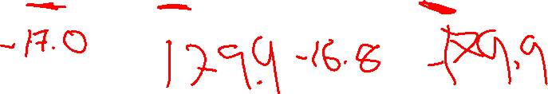
Numeric Data
City 1 Lat. | City 1 Long. | City 2 Lat. | City 2 Long. | Drivable?
46.71 | 123.24 | 47.34 | 121.33 | Yes
56.91 | 123.24 | 55.23 | 121.33 | Yes
46.71 | 123.24 | 55.34 | 121.33 | No
46.71 | 123.24 | 47.34 | 130.99 | No
-89.99 | -25 | -89.99 | 175 | Yes
179.9 | -17.0 | -179.9 | -16.8 | Yes

Slide 81
Numeric Data
City 1 Lat. | City 1 Long. | City 2 Lat. | City 2 Long. | Drivable?
46.71 | 123.24 | 47.34 | 121.33 | Yes
56.91 | 123.24 | 55.23 | 121.33 | Yes
46.71 | 123.24 | 55.34 | 121.33 | No
46.71 | 123.24 | 47.34 | 130.99 | No
-89.99 | -25 | -89.99 | 175 | Yes
179.9 | -17.0 | -179.9 | -16.8 | Yes
https://en.wikipedia.org/wiki/Taveuni

Slide 82
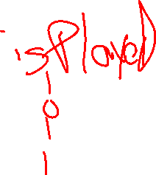
Numeric Data - Binarization
Genre | Artist | Plays
Pop | Rihanna | 1056219
Pop | Dr. Quigley | 0
R&B | Tupac | 11234
Jazz | Dave Brubeck | 183

Slide 83

Numeric Data - Rounding
Genre | Artist | Plays
Pop | Rihanna | 1056219
Pop | Dr. Quigley | 0
R&B | Tupac | 11234
Jazz | Dave Brubeck | 183

Slide 84
Text Data
That album was great! I loved it the best out of all my music collection.
Others think it was cool, but I’m tired of holiday music, I thought the album was bad.

Slide 85

Text Data - Tokenization
That album was great! I loved it the best out of all my music collection.
Others think it was cool, but I’m tired of holiday music, I thought the album was bad.

Slide 86
Text Data - Tokenization
Natural Language Toolkit – nltk.org
Positive | Negative | Negative | Negative | Positive
Great | Cool | Worst | Depressing | Cool
Love | Tired | Sad | Worst | Amazing
Best | Bad | Angry | No | Sweet

Slide 87
Text Data - Featurization
Linguists, etc. have worked to group words under various categories
- Part of speech, sentiment, others
Leverage details about the words as features
Positive | Negative | Negative | Negative | Positive
Great | Cool | Worst | Depressing | Cool
Love | Tired | Sad | Worst | Amazing
Best | Bad | Angry | No | Sweet

Slide 88
Text Data – Sentiment Tagging
Tokenize our sentences
Look up the features for each token
Use these as new features in a classifier
- There’s a whole field around developing databases of features
http://www.nltk.org/howto/sentiment.html
Positive | Negative | Negative | Negative | Positive
Great | Cool | Worst | Depressing | Cool
Love | Tired | Sad | Worst | Amazing
Best | Bad | Angry | No | Sweet

Slide 89
Sequential Data
I have a series of inputs that I want to combine to do classification
- We have a series of locations, can we gauge trajectory?
- We have 100 readings from an accelerometer, can we get gait?
- We have recent weather readings, can we better predict it?

Slide 90
Sequential Data
I have a series of inputs that I want to combine to do classification
- We have a series of locations, can we gauge trajectory?
- We have 100 readings from an accelerometer, can we get gait?
- We have recent weather readings, can we better predict it?
For those who need advanced techniques quickly for their projects, check out Bayesian Reasoning & Machine Learning Ch. 23 - 26

Slide 91
Sequential Data
Timestamp | User | Action
100 | David | Copy
150 | David | Paste
200 | David | Copy
250 | David | Paste

Slide 92
Sequential Data – Past Actions as Features
Timestamp | User | PrevAction | Action
100 | David | Login | Copy
150 | David | Copy | Paste
200 | David | Paste | Copy
250 | David | Copy | Paste

Slide 93
Sequential Data – Past Actions as Features
Can this scale? Does this give us enough info?
Timestamp | User | PrevAction | Action
100 | David | Login | Copy
150 | David | Copy | Paste
200 | David | Paste | Copy
250 | David | Copy | Paste

Slide 94
Sequential Data – Past Actions as Features
You could do this forever…
Timestamp | User | N-2Action | PrevAction | Action
100 | David | N/A | Login | Copy
150 | David | Login | Copy | Paste
200 | David | Copy | Paste | Copy
250 | David | Paste | Copy | Paste

Slide 95
Curse of Dimensionality
Features have a value and a cost
- Value: benefit to your training / accuracy
- Cost: Computation time, memory
Time & Effort to collect
If you’re going to include a feature, it better be worth it!
Lots of ways to evaluate / measure the usefulness of a feature…
https://www.kdnuggets.com/2017/04/must-know-curse-dimensionality.html

Slide 96
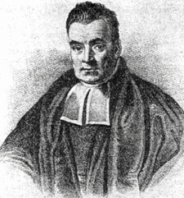
Naïve Bayes

Slide 97
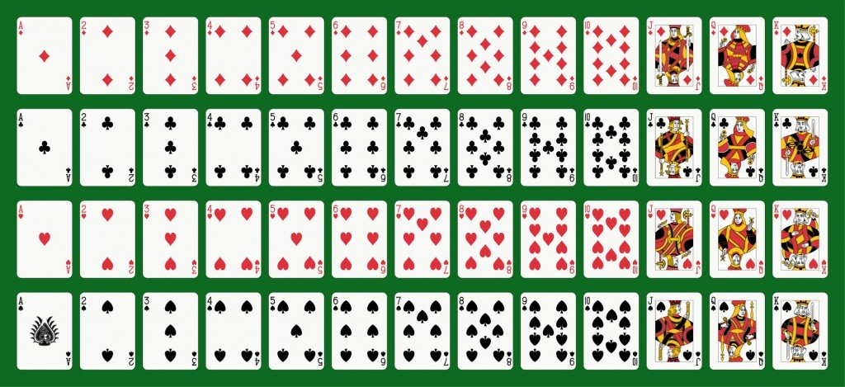
Probability Refresher (see Add’l Reading)
52 Cards
2 Colors {Red, Black}
4 Suits {D,C,H,S}
13 Values {A,2,3,…K}
Notes:
https://www.scienceabc.com/wp-content/uploads/2016/05/Fotolia_23299310_Subscription_Monthly_M.jpg

Slide 98
Probability Refresher
V – Random variable of Value
v = “ace”, v = 7, etc.
p(v) = probability that card has value “v”
C – Random variable of Color
C = Red or C = Black
p(c) = probability that card has color “c”
Joint probability – probability of multiple events simultaneously
p(v,c) = probability that card has value “v” and color “c”
probability of a Red 7 can be written as p(v=7,c=red) or p(7,red)

Slide 99



Probability Refresher – Product Rule
Product rule: p(A,B) = p(A|B)*p(B) = p(B|A)*p(A)
The Joint probability is equal to to the conditional probability multiplied by the probability of the condition (the marginal probability).
p(C,V) = p(C|V)*p(V) = p(V|C)*p(C)
P(Red,7) =
p(Red) =
P(7) =
p(Red,7) =

Slide 100
Wednesday

Slide 101
Course Logistics
Problem Set 1 – Due Wednesday, February 8 – TODAY 11:59PM
Problem Set 2 – Releases ASAP (Hopefully before 3PM)
If it’s not out tonight we’ll investigate moving things around…
Weekly Activity – Jupyter Notebook uploaded – submit Notebook on Canvas
Project Milestone 2 – Due Friday, Feb. 17
Groups are not set up yet (9AM Wednesday), but hopefully should be up ASAP (talking about it in our 3PM meeting). Submissions will work by grouping – we’ll look at that once groups are set.

Slide 102
Project Milestone 2: Pitch
1 Minute, 30 Second presentation
There is some leeway in this time limit, but not much. Videos that are too long will lose points!
Up to 4 Page write-up
This is longer than most groups should need.
This can ignore title pages, etc., but honestly I prefer a small header with group details.
(Milestone 2.1: Feedback on Peers will be discussed later)
The Milestone 2 Deliverables should be for an audience ignorant of your previous work!

Slide 103
Project Milestone 2: Pitch
Problem Space
This is covering again the stuff you talked about in Milestone 1. You can reuse text!

Slide 104
Project Milestone 2: Pitch
Dataset
Number of Entries / Samples (approximate is fine)
Number of Features per Entry
Description of some of the most important features
Outcome variables (if applicable)

Slide 105
Project Milestone 2: Pitch
Approach
Methods for implementing a solution
What kind of problem are you facing? Classification? Regression? What sorts of problems do you foresee?
Imbalanced Classes? High Dimensionality? Small number of samples? Too many samples? Time / sequential issues?
How your idea differs from others in the field
May be skipped in video, but should be in your writeup
Any stretch goals?

Slide 106
Naïve Bayes

Slide 107
Probability Refresher – Product Rule
Product rule: p(A,B) = p(A|B)*p(B) = p(B|A)*p(A)
The Joint probability is equal to to the conditional probability multiplied by the probability of the condition (the marginal probability).
p(C,V) = p(C|V)*p(V) = p(V|C)*p(C)
P(Red,7) =
p(Red) =
P(7) =
p(Red,7) =

Slide 108
Probability Refresher – Chain Rule
For three variables, A,B,C, we can use the Product Rule repeatedly to show:
p(A,B,C) = p(a) * p(b|a) * p(c|b,a)
For i random variables X_{1:I}, we have:
p(X_{1:i}) = p(X₁) * p(X₂|X₁) * … * p(X_{i}|X_{1:i-1})
Proving the Chain Rule is left as an exercise for the interested student

Slide 109
Probability Refresher – Sum Rule
Conversely, if we know the joint probabilities, we can compute the marginal.
p(A) = ∑_{b}p(A,B=b) = ∑_{b}p(A|B=b) * p(B=b)
Given p(C=Red,V=7) and p(C=Black,V=7), calculate p(V=7)

Slide 110
Probability – Bayes Rule
p(A,B) = p(A|B)*p(B) = p(B|A)*p(A)
p(X,Y) = p(Y|X)*p(X) → p(Y|X) = p(X,Y) / p(X) $→ p(Y|X) = (p(X|Y)*p(Y)) / p(X)
p(Y|X) = p(X|Y)*p(Y)
p(X)
$ = assuming p(X) > 0 (i.e. our data is possible)

Slide 111
Naïve Bayes Classification
We want to model the joint probability: p(x,y)
What we actually care about is the probability of our answer given the data: p(y|x)
p(Y|X) = p(X|Y)*p(Y)
p(X)
Or…
Posterior probability = class-conditional * prior
evidence

Slide 112
Naïve Bayes Classification – Posterior
“What is the possibility that an example is of class c given its observed features?”
- What is the probability it is a grad (pos) given its HS outcomes?
Given a HS x:
If p(pos | x) >= p(neg | x)
classify as pos
Else
classify as neg

Slide 113
Class-conditional probability p(X | Y)
i.e. “Likelihood”
“Given (or assuming) y = c, what is the probability x is observed?”
“Given my assumptions about failing students, what’s the probability that I see this particular student?”
p(x = [GPA=1.2,SAT=550] | y = neg)
NOTE: Now we’re assuming joint probability of features

Slide 114
Naïve Bayes – Assumption of Independence
Features of x are conditionally independent for a given class y.

Slide 115
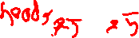
Naïve Bayes – Assumption of Independence
Features of x are conditionally independent for a given class y.
Take two weighted coins, C₁ and C₂.

Slide 116
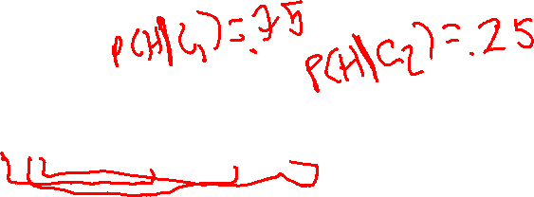
Naïve Bayes – Assumption of Independence
Features of x are conditionally independent for a given class y.
Take two weighted coins, C₁ and C₂.
Pick a coin and flip it 3 times. Which coin did we flip?
p(x=[HHT] | C₁) = p(H|C₁) * p(H|C₁) * p(T|C₁)
Vs
p(x=[HHT] | C₂) = p(H|C₂) * p(H|C₂) * p(T|C₂)

Slide 117
Naïve Bayes – Assumption of Independence
Features of x are conditionally independent for a given class y.
Take two weighted coins, C₁ and C₂.
Pick a coin and flip it 3 times. Which coin did we flip?
p(x=[HHT] | C₁) = p(H|C₁) * p(H|C₁) * p(T|C₁)
Vs
p(x=[HHT] | C₂) = p(H|C₂) * p(H|C₂) * p(T|C₂)
Draw 3 cards from a deck of cards, one at a time (no replacement). Does this still hold?

Slide 118
Naïve Bayes – Assumption of Independence
Features of x are conditionally independent for a given class y.
p(x=[GPA=1.2,SAT=550,ACT=21] | neg) = p(GPA=1.2 | neg) * p(SAT=550| neg) * p(ACT=21 | neg)
Is this valid?
Probably not, but a) we’ll make the assumptions for both pos and neg, and b) it makes feature conditionals easy to estimate

Slide 119
Naïve Bayes – Class-Conditional Probability
Features of x are conditionally independent for a given class y.
p(x=[GPA=1.2,SAT=550,ACT=12] | neg) = p(GPA=1.2| neg) * p(SAT=550| neg) * p(ACT=21 | neg)
How do we calculate the class-conditional probability?
Estimate from Data!
P(GPA=1.2| neg) = # failing students with a HS GPA of 1.2
# failing students

Slide 120

Naïve Bayes Classification
We want to model the joint probability: p(x,y)
What we actually care about is the probability of our answer given the data: p(y|x)
p(Y|X) = p(X|Y)*p(Y)
p(X)
Or…
Posterior probability = class-conditional * prior
evidence

Slide 121
Prior Probability p(y)
“What is the probability of encountering class c?”
p(neg) = “What is the probability that any given student will fail?”
How do we get this information?

Slide 122
Prior Probability p(y)
“What is the probability of encountering class c?”
p(neg) = “What is the probability that any given student will fail?”
How do we get this information?
Estimate it from Data!
P(neg) = # failing students
# students

Slide 123

Naïve Bayes Classification
We want to model the joint probability: p(x,y)
What we actually care about is the probability of our answer given the data: p(y|x)
p(Y|X) = p(X|Y)*p(Y)
p(X)
Or…
Posterior probability = class-conditional * prior
evidence

Slide 124
Evidence p(x)
“The probability of encountering x independent of class”
“the probability of getting that exact HS outcome”
We could estimate this using our data…

Slide 125
Naïve Bayes Classification
“What is the possibility that an example is of class c given its observed features?”
- What is the probability it is a positive grad given its HS features ?
Given HS features x:
If p(pos | x) >= p(neg | x)
classify as pos
Else
classify as neg

Slide 126
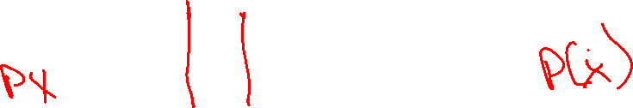
Evidence p(x)
“The probability of encountering x independent of class”
“the probability of getting that exact message”
We could estimate this using our data…
But it doesn’t actually matter in our decision making process
p(x | pos) * p(pos) >=<? p(x | neg) * p(neg)
p(x) p(x)

Slide 127
Evidence p(x)
“The probability of encountering x independent of class”
“the probability of getting that exact message”
We could estimate this using the sum rule…
But it doesn’t actually matter in our decision making process
p(x | pos) * p(pos) >=<? p(x | neg) * p(neg)
It’s not really probability anymore, but we have scores for each condition…

Slide 128
Naïve Bayes Classification - Example
 | Pos | Neg | Neg | Neg | Pos
GPA | 2.5 | 1.9 | 1.2 | 2.1 | 4.0
SAT | 1100 | 990 | 750 | 1100 | 1600
ACT | 21 | 16 | 16 | 21 | 36

Slide 129
Naïve Bayes Classification - Example
If I get a new student with [GPA = 1.2, SAT = 550, ACT = 21], do we expect them to graduate (pos) or not (neg)?
 | Pos | Neg | Neg | Neg | Pos
GPA | 2.5 | 1.9 | 1.2 | 2.1 | 4.0
SAT | 1100 | 990 | 750 | 1100 | 1600
ACT | 21 | 12 | 16 | 21 | 36

Slide 130
Naïve Bayes Classification - Example
If I get a new student with [GPA = 1.2, SAT = 550, ACT = 21], do we expect them to graduate (pos) or not (neg)?
 | Pos | Neg | Neg | Neg | Pos | ???
GPA | 2.5 | 1.9 | 1.2 | 2.1 | 4.0 | 1.2
SAT | 1100 | 990 | 750 | 1100 | 1600 | 550
ACT | 21 | 12 | 16 | 21 | 36 | 21

Slide 131
Naïve Bayes Classification - Example
If I get a new student with [GPA = 1.2, SAT = 550, ACT = 21], do we expect them to graduate (pos) or not (neg)?
p(pos | 1.2, 550, 21) >=<? p(neg | 1.2,550,21)
 | Pos | Neg | Neg | Neg | Pos | ???
GPA | 2.5 | 1.9 | 1.2 | 2.1 | 4.0 | 1.2
SAT | 1100 | 990 | 750 | 1100 | 1600 | 550
ACT | 21 | 12 | 16 | 21 | 36 | 21

Slide 132
Naïve Bayes Classification - Example
If I get a new student with [GPA = 1.2, SAT = 550, ACT = 21], do we expect them to graduate (pos) or not (neg)?
p(pos | 1.2, 550, 21) = ???
 | Pos | Neg | Neg | Neg | Pos | ???
GPA | 2.5 | 1.9 | 1.2 | 2.1 | 4.0 | 1.2
SAT | 1100 | 990 | 750 | 1100 | 1600 | 550
ACT | 21 | 12 | 16 | 21 | 36 | 21

Slide 133
Naïve Bayes Classification - Example
If I get a new student with [GPA = 1.2, SAT = 550, ACT = 21], do we expect them to graduate (pos) or not (neg)?
PRODUCT RULE
p(pos | 1.2, 550, 21) = p(1.2, 550, 21 | pos) * p(pos)
 | Pos | Neg | Neg | Neg | Pos | ???
GPA | 2.5 | 1.9 | 1.2 | 2.1 | 4.0 | 1.2
SAT | 1100 | 990 | 750 | 1100 | 1600 | 550
ACT | 21 | 12 | 16 | 21 | 36 | 21

Slide 134
Naïve Bayes Classification - Example
If I get a new student with [GPA = 1.2, SAT = 550, ACT = 21], do we expect them to graduate (pos) or not (neg)?
ASSUME INDEPENDENCE
p(pos | 1.2, 550, 21) = p(1.2 | pos) * p(550 | pos) * p(21 | pos) * p(pos)
 | Pos | Neg | Neg | Neg | Pos | ???
GPA | 2.5 | 1.9 | 1.2 | 2.1 | 4.0 | 1.2
SAT | 1100 | 990 | 750 | 1100 | 1600 | 550
ACT | 21 | 12 | 16 | 21 | 36 | 21

Slide 135
Overcoming Data Problems
We’ve never seen a student with an SAT of 550 before! How might you address this?
 | Pos | Neg | Neg | Neg | Pos | ???
GPA | 2.5 | 1.9 | 1.2 | 2.1 | 4.0 | 1.2
SAT | 1100 | 990 | 750 | 1100 | 1600 | 550
ACT | 21 | 12 | 16 | 21 | 36 | 21

Slide 136
Overfitting Solutions - Binning
Binning – Assign values to bins
Bins can vary in size, number, shape
- Equity concern?
 | Pos | Neg | Neg | Neg | Pos | ???
GPA | C | D | D | C | A | D
SAT | 1001-1400 | 751-1000 | 0-750 | 1001-1400 | 1401-1600 | 0-750
ACT | 21-25 | 11-15 | 16-20 | 21-25 | 31-36 | 21-25

Slide 137
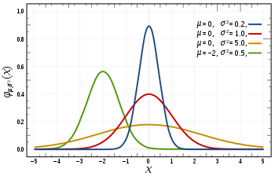
Overfitting Solutions – Increasing Sample Size
“If I just keep taking samples, surely I’ll eventually cover my whole sample space!”

Slide 138
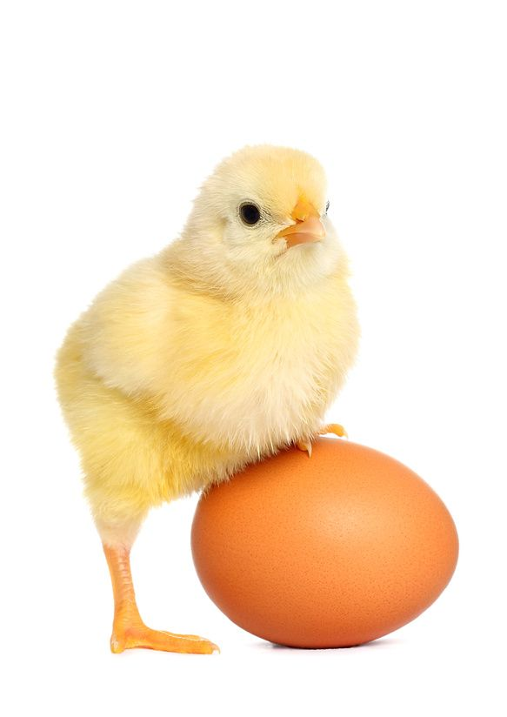
Overfitting Solutions – Targeted Sampling
“If I know to expect something, I can go seek out examples for training!”
 | Pos | Neg | Neg | Neg | Pos | ???
GPA | C | D | D | C | A | D
SAT | 1001-1400 | 751-1000 | 0-750 | 1001-1400 | 1401-1600 | 0-750
ACT | 21-25 | 11-15 | 16-20 | 21-25 | 31-36 | 21-25
Notes:
https://www.applicoinc.com/wp-content/uploads/2014/12/chicken-and-egg.jpg
https://cdn0.wideopenspaces.com/wp-content/uploads/2014/11/ftd-nimrodlion.jpg
https://cdn-images-1.medium.com/max/2600/1*9Z6W_yHevsq2jQZE9VK5rw.jpeg
https://i.redd.it/jc713jekk9901.jpg

Slide 139
Overfitting Solutions – Trust the Experts
Sometimes there could be databases or lists of interest to your problem, e.g. a “cutoff score” for SAT scores, or a “valence score” for NLP word connotations.
- Does it actually fit my problem space?
- Do I trust it?

Slide 140
Naïve Bayes Classification - Example
If I get a new student with [GPA = 1.2, SAT = 550, ACT = 21], do we expect them to graduate (pos) or not (neg)?
p(pos | 1.2, 550, 21) >=<? p(neg | 1.2,550,21)
 | Pos | Neg | Neg | Neg | Pos | ???
GPA | 2.5 | 1.9 | 1.2 | 2.1 | 4.0 | 1.2
SAT | 1100 | 990 | 750 | 1100 | 1600 | 550
ACT | 21 | 12 | 16 | 21 | 36 | 21

Slide 141
Naïve Bayes Classification - Example
If I get a new student with [GPA = 1.2, SAT = 550, ACT = 21], do we expect them to graduate (pos) or not (neg)?
p(pos | 1.2, 550, 21) = ???
 | Pos | Neg | Neg | Neg | Pos | ???
GPA | 2.5 | 1.9 | 1.2 | 2.1 | 4.0 | 1.2
SAT | 1100 | 990 | 750 | 1100 | 1600 | 550
ACT | 21 | 12 | 16 | 21 | 36 | 21

Slide 142
Naïve Bayes Classification - Example
If I get a new student with [GPA = 1.2, SAT = 550, ACT = 21], do we expect them to graduate (pos) or not (neg)?
ASSUME INDEPENDENCE
p(pos | 1.2, 550, 21) = p(1.2 | pos) * p(550 | pos) * p(21 | pos) * p(pos)
 | Pos | Neg | Neg | Neg | Pos | ???
GPA | 2.5 | 1.9 | 1.2 | 2.1 | 4.0 | 1.2
SAT | 1100 | 990 | 750 | 1100 | 1600 | 550
ACT | 21 | 12 | 16 | 21 | 36 | 21

Slide 143
Overcoming Data Problems
We’ve never seen a student with an SAT of 550 before! How might you address this?
 | Pos | Neg | Neg | Neg | Pos | ???
GPA | 2.5 | 1.9 | 1.2 | 2.1 | 4.0 | 1.2
SAT | 1100 | 990 | 750 | 1100 | 1600 | 550
ACT | 21 | 12 | 16 | 21 | 36 | 21

Slide 144

Overfitting Solutions - Smoothing
Builds on the assumption that “nothing is impossible”
Notes:
https://media1.tenor.com/images/0a6182efc5ec93a6242b570f81394c0e/tenor.gif?itemid=11098164

Slide 145
Overfitting Solutions - Smoothing
Step 1) Start with a completely naïve, untrained understanding
- “a) All possible examples are equally likely to exist in my problem space and b) All classes are equally likely”
- All HS features are equally likely to appear in a student and all students are equally likely to be positive or negative
p(x) = 1 p(y) = 1
|V| |Y|

Slide 146
Overfitting Solutions - Smoothing
Step 2) Add our training cases to the evidence set
BEFORE
p(x|y) = p(x,y) = # positive grads with “x” in them
p(y) # positive grads
AFTER
p(x|y) = p(x,y) + 1 = # positive grads with “x” (found in training) + 1
p(y) +|V| # positive grads (in training) + tot. student options
Add-1 or Laplace Smoothing

Slide 147
Overfitting Solutions - Smoothing
Step 2) Add our training cases to the evidence set
BEFORE
p(y) = # positive students
# students
AFTER
p(y) = # positive students (found in training) + 1
# students (found in training) + total classes
Add-1 or Laplace Smoothing

Slide 148
Overcoming Data Problems
Binning + Smoothing
GPA: 5 Bins - A, B, C, D, F
SAT: 2 Bins - >600
ACT: 2 Bins - >25
 | Pos | Neg | Neg | Neg | Pos | ???
GPA | 2.5 | 1.9 | 1.2 | 2.1 | 4.0 | 1.2
SAT | 1100 | 990 | 750 | 1100 | 1600 | 550
ACT | 21 | 12 | 16 | 21 | 36 | 21

Slide 149

Naïve Bayes Classification
If I get a new student with [GPA = 1.2, SAT = 550, ACT = 21], do we expect them to graduate (pos) or not (neg)?
p(pos | 1.2, 550, 21) = p(D | pos) * p(- | pos) * p(Low | pos) * p(pos)
 | Pos | Neg | Neg | Neg | Pos | ???
GPA | C | D | D | C | A | D
SAT | + | + | + | + | + | -
ACT | Low | Low | Low | Low | High | Low

Slide 150
Naïve Bayes Classification
p(pos | 1.2, 550, 21) = p(D | pos) * p(- | pos) * p(Low | pos) * p(pos)
 | Pos | Neg | Neg | Neg | Pos | ???
GPA | C | D | D | C | A | D
SAT | + | + | + | + | + | -
ACT | Low | Low | Low | Low | High | Low

Slide 151

Naïve Bayes Classification
p(pos | 1.2, 550, 21) = p(D | pos) * p(- | pos) * p(Low | pos) * p(pos)
Add-1 Smoothing
p(x|y) = p(x,y) + 1 = # positive grads with “x” (found in training) + 1
p(y) +|V| # positive grads (in training) + tot. student options
p(y) = # positive students (found in training) + 1
# students (found in training) + total classes
 | Pos | Neg | Neg | Neg | Pos | ???
GPA | C | D | D | C | A | D
SAT | + | + | + | + | + | -
ACT | Low | Low | Low | Low | High | Low

Slide 152
Friday

Slide 153
Course Logistics
Problem Set 2 – Released!
Weekly Activity – Jupyter Notebook uploaded – submit Notebook on Canvas
Project Milestone 2 – Due Friday, Feb. 17
Groups are set up, Milestone 1 Feedback is in canvas (but not yet posted due to a bug, working on it)
I invite further conversations about your projects in OH, before / after class, etc. I went through them all, but they are a bit of a blur so you’ll have to remind me what you’re doing.

Slide 154
Project Milestone 1
The majority of the class did not add sufficient depth to their project.
You should define how your work differs from the work available in Kaggle notebooks on the same dataset. You can’t just reproduce results!
Make sure you follow the instructions of the report
Page length, etc.

Slide 155
Naïve Bayes Classification
We want to model the joint probability: p(x,y)
What we actually care about is the probability of our answer given the data: p(y|x)
p(Y|X) = p(X|Y)*p(Y)
p(X)
Or…
Posterior probability = class-conditional * prior
evidence

Slide 156
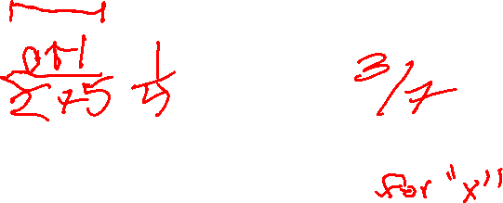
Naïve Bayes Classification
p(pos | 1.2, 550, 21) = p(D | pos) * p(- | pos) * p(Low | pos) * p(pos)
Add-1 Smoothing
p(x|y) = p(x,y) + 1 = # positive grads with “x” (found in training) + 1
p(y) +|V| # positive grads (in training) + tot. student options
p(y) = # positive students (found in training) + 1
# students (found in training) + total classes
 | Pos | Neg | Neg | Neg | Pos | ???
GPA | C | D | D | C | A | D
SAT | + | + | + | + | + | -
ACT | Low | Low | Low | Low | High | Low

Slide 157
Naïve Bayes Classification
p(pos | 1.2, 550, 21) = p(D | pos) * p(- | pos) * p(Low | pos) * p(pos)
= 1/7 * 1/4 * 2/4 * 3/7 = 3/392 or 0.0077ish
Add-1 Smoothing
p(x|y) = p(x,y) + 1 = # positive grads with “x” (found in training) + 1
p(y) +|V| # positive grads (in training) + tot. student options
p(y) = # positive students (found in training) + 1
# students (found in training) + total classes
 | Pos | Neg | Neg | Neg | Pos | ???
GPA | C | D | D | C | A | D
SAT | + | + | + | + | + | -
ACT | Low | Low | Low | Low | High | Low

Slide 158
Naïve Bayes Classification
p(neg | 1.2, 550, 21) = p(D | neg) * p(- | neg) * p(Low | neg) * p(neg)
Add-1 Smoothing
p(x|y) = p(x,y) + 1 = # negative grads with “x” (found in training) + 1
p(y) +|V| # negative grads (in training) + tot. student options
p(y) = # negative students (found in training) + 1
# students (found in training) + total classes
 | Pos | Neg | Neg | Neg | Pos | ???
GPA | C | D | D | C | A | D
SAT | + | + | + | + | + | -
ACT | Low | Low | Low | Low | High | Low

Slide 159
Naïve Bayes Classification
p(neg | 1.2, 550, 21) = p(D | neg) * p(- | neg) * p(Low | neg) * p(neg)
= 3/8 * 1/5 * 4/5 * 4/7 = 6/175 or 0.034ish
Add-1 Smoothing
p(x|y) = p(x,y) + 1 = # negative grads with “x” (found in training) + 1
p(y) +|V| # negative grads (in training) + tot. student options
p(y) = # negative students (found in training) + 1
# students (found in training) + total classes
 | Pos | Neg | Neg | Neg | Pos | ???
GPA | C | D | D | C | A | D
SAT | + | + | + | + | + | -
ACT | Low | Low | Low | Low | High | Low

Slide 160
Overfitting Solutions – K Smoothing
Step 1) Start with a completely naïve, untrained understanding
- “a) All possible examples are equally likely to exist in my problem space and b) All classes are equally likely”
- All HS features are equally likely to appear in a student and all students are equally likely to be positive or negative
p(x) = K p(y) = K
K*|V| K*|Y|

Slide 161
Naïve Bayes - Probabilities
The probability of tweet x of length D being of class y
p(y|x) = p(y) * ∏_{i=1→D}(p(x_{i}|y))
We get some complicated, small numbers multiplication
- Theoretically valid
- We work with finite computing machines
- Leads to underflow
Let’s take the logarithm instead!

Slide 162
Naïve Bayes – Logarithms (ln)
Logarithm math refresher:
- ln(ab) = ln(a) + ln(b)
- ln(x) is monotonically increasing, so argmax() is still valid
y = argmax_{c} ln(p(c)) + ∑_{i=1→D}ln(p(x_{i}|c))

Slide 163
Linear Regression

Slide 164


Housing Market
Notes:
https://cdn.houseplans.com/product/q5qkhirat4bcjrr4rpg9fk3q94/w800x533.jpg?v=8
https://images.dwell.com/photos/6328431439726800896/6445880622670512128/large.jpg

Slide 165
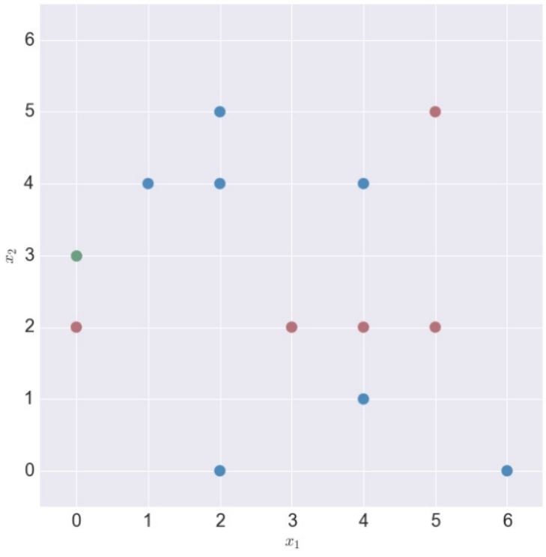
Regression – K-Nearest Neighbors
Our Y values are now Numeric
120
95
100
120
75
82
120
67

Slide 166
Housing Market – Decision Tree
Bedrooms < 2
$100k
Bedrooms < 4
Bathrooms < 2
Bedrooms < 6
$200k
$300k
…

Slide 167
Housing Market – Decision Forest
Bedrooms < 2
Bedrooms < 2
$100k
$140k
Bedrooms < 4
Bedrooms < 4
Bathrooms < 2
Bedrooms < 6
Market = Coastal
Bedrooms < 6
$200k
$300k
…
$500k
$250k
…

Slide 168
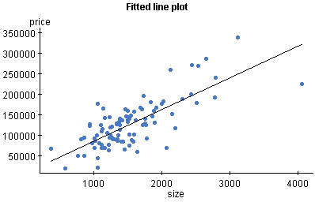
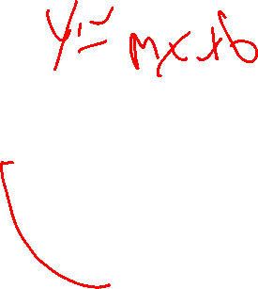
Linear Regression – The Basics

Slide 169
Linear Regression – The Basics
Y ≈ β₀ + β₁X.
y = w₀ + w₁*x

Slide 170
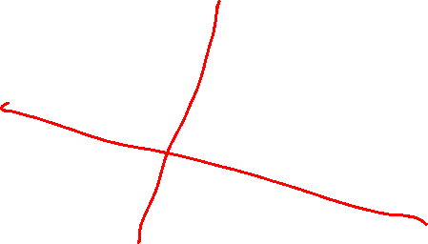
Linear Regression – The Basics
Y ≈ β₀ + β₁X.
y = w₀ + w₁*x
How do I find (or generate) this line of best fit?

Slide 171
Linear Regression – Multiple Dimensions
X = [x₁], we care about w₀ (bias, intercept) + w₁(weight, slope) * x₁
What about multiple dimensions?

Slide 172
Linear Regression – Multiple Dimensions
X = [x₁], we care about w₀ (bias, intercept) + w₁(weight, slope) * x₁
What about multiple dimensions? Each Dimension Gets a Weight!
X = [x₁, x₂, x₃,…, x_{n}]
w₀ + w₁ * x₁ + w₂ * x₂ + w₃ * x₃ + … + w_{n} * x_{n} = W ∙ X
(NOTE: For dot product to work, X needs to be prepended, X = [1,x₁, …]

Slide 173
Linear Regression – The Details
First, let’s define “how good” a line is.
- How well does it define our points?

Slide 174
Linear Regression – The Details
First, let’s define “how good” a line is.
- How well does it define our points?
How far away, on average, is each point from the line? The difference between each point and the line along the output axis
(square this value to get it to always be a positive value)
The Residual Sum of Squares
Take the mean of this value over all points
The Mean Squared Error

Slide 175
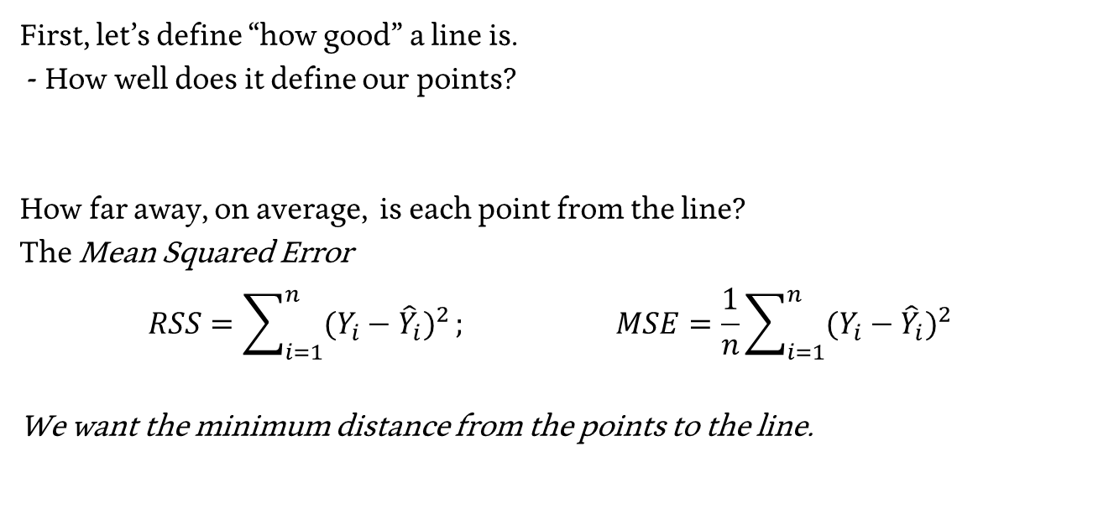
Linear Regression – The Details
First, let’s define “how good” a line is.
- How well does it define our points?
How far away, on average, is each point from the line?
The Mean Squared Error
$$RSS=\sum_{i=1}^{n}{{(Y_{i}−{\hat{Y}}_{i})}^{2}}; MSE=\frac{1}{n}\sum_{i=1}^{n}{{(Y_{i}−{\hat{Y}}_{i})}^{2}}$$
We want the minimum distance from the points to the line.

Slide 176
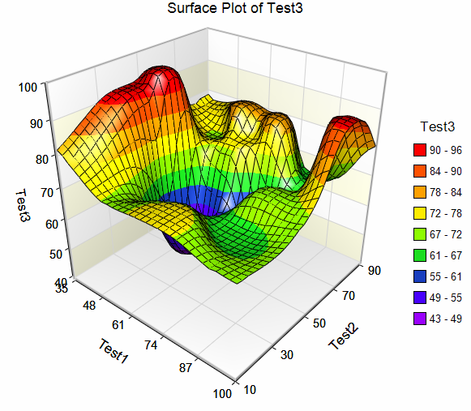
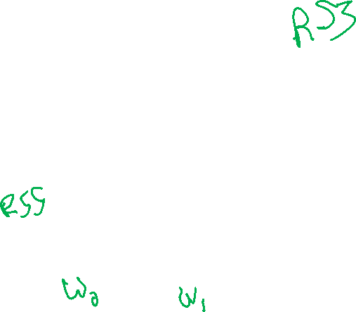
Minimizing a function…
Assume Test1 and Test2 are our w values, we want to minimize Test3. How would you do it?
Notes:
https://sg.fiverrcdn.com/photos/99524726/original/bb6eda30c9f6992ac0681a9c8ea5f25c656aa4c8.png?1500226043

Slide 177

Optimize by checking all points, choosing min

Slide 178
Optimizing using the gradient
For any function f, there exists a gradient.
The gradient is the vector that points in the direction in which f is increasing the fastest.

Slide 179

Optimize using the gradient

Slide 180
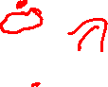
Optimizing argmin(MSE(w))
Gradient descent would not work for any given function…
Notes:
https://sg.fiverrcdn.com/photos/99524726/original/bb6eda30c9f6992ac0681a9c8ea5f25c656aa4c8.png?1500226043

Slide 181
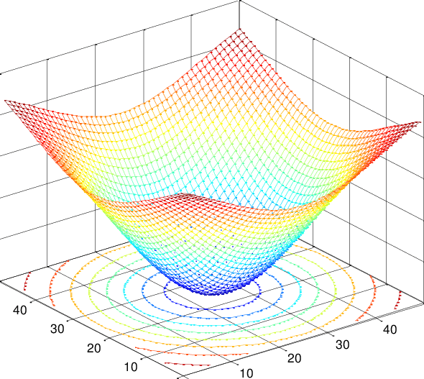

Optimizing argmin(MSE(w))
But our function is a linear function, which happens to be convex!
i.e. If we’re at a local minimum, we’re at the global minimum
Notes:
https://www.researchgate.net/profile/Maria_Barbarosou/publication/230787652/figure/fig2/AS:669131099623428@1536544694590/The-2D-Caussian-function-of-Example-2-Example-1-Consider-the-following-strongly-convex.png

Slide 182
Optimizing using Gradient Descent
We can think of this in terms of updating our weights:
w ← w – ∇_{w} MSE(w)
∇_{w} MSE(w) = [∂MSE(w) / ∂w₀, ∂MSE(w) / ∂w₁, … , ∂MSE(w) / ∂w_{n}]
The weights are updated by removing the gradient
Each weight is updated by subtracting its partial derivative

Slide 183
Optimizing using Gradient Descent
We can think of this in terms of a rate of change:
w ← w – λ * ∇_{w} MSE(w)

Slide 184
Optimizing using Gradient Descent
We can think of this in terms of each feature weight’s update:
w_{k} ← w_{k} – λ * ∂MSE(w) / ∂w_{k} for each k = 0 → D (dimensions)

Slide 185
Optimizing using Gradient Descent
We can think of this in terms of each feature weight’s update:
w_{k} ← w_{k} – λ * ∂MSE(w) / ∂w_{k} for each k = 0 → D (dimensions)
We can think of the partial derivative* of w_{k} in terms of the k^{th} feature of the i^{th} training example
*The proof of this fact can be found in readings… (i.e. it’s really hard math!)

Slide 186
Optimizing using gradient descent
w = //initial weights
x = //training examples (2d matrix)
y = //training answers (1d vector)
Lamda = //rate
While not converged():
For k in range(0,D): //for each dimension
update[k] = 0
for i in range(0,n): //for each training example
update[k] = (sigm(dot(w, x[i,:])) – y[i]) * x[i,k]
w = w – lamda * update

Slide 187

Gradient Descent – Real World Examples
Real world example: predicting the weather
Notes:
https://thumbs.dreamstime.com/z/sun-clouds-rain-snow-storms-14353589.jpg

Slide 188
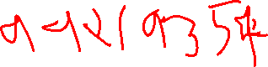
Gradient Descent – Predicting the weather
We have relevant features (precipitation, humidity, wind, latitude, longitude, time of day, day of year…
- say 99 features, across 19,354 “incorporated places” in us
- current temperature regression
We have sampled data points
- 1 sample per site per minute for 30 years
Notes:
https://thumbs.dreamstime.com/z/sun-clouds-rain-snow-storms-14353589.jpg

Slide 189
Gradient Descent – Predicting the weather
We have relevant features (precipitation, humidity, wind, latitude, longitude, time of day, day of year…
- say 99 features, across 19,354 “incorporated places” in us
- plus current temperature
We have sampled data points
- 1 sample per site per minute for 30 years
3.05e+13 features
There are bigger problems out there!
We’ll solve that problem soon…
Notes:
https://thumbs.dreamstime.com/z/sun-clouds-rain-snow-storms-14353589.jpg

Slide 190
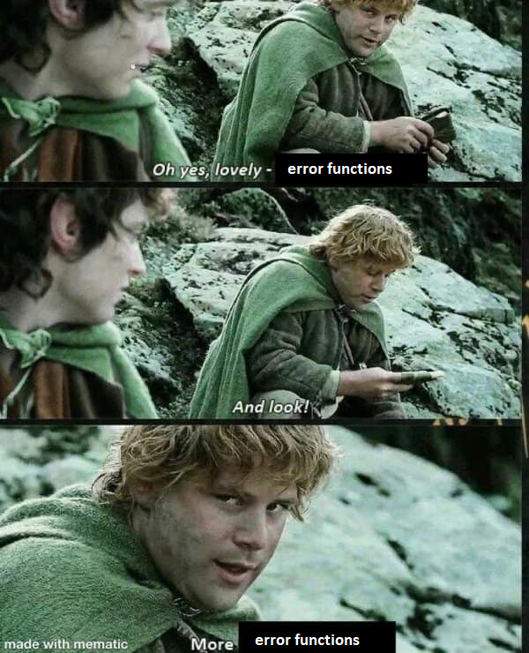
More Errors

Slide 191
Curse of Dimensionality
Features have a value and a cost
- Value: benefit to your training / accuracy
- Cost: Computation time, memory
Time & Effort to collect
If you’re going to include a feature, it better be worth it!
Lots of ways to evaluate / measure the usefulness of a feature…
https://www.kdnuggets.com/2017/04/must-know-curse-dimensionality.html

Slide 192
Curse of Dimensionality – Leave-one-out
Train & evaluate your classifier while leaving out one feature at a time.
MSE: 52K
Log Sq Ft | # Bedrooms | House Lat. | House Long. | Cost
3.2 | 4 | 121.33 | 47.34 | 500K
3.09 | 3 | 121.33 | 55.23 | 450K
2.87 | 2 | 121.33 | 55.34 | 200K
3.06 | 2 | 130.99 | 47.34 | 1500K

Slide 193
Curse of Dimensionality – Leave-one-out
Train & evaluate your classifier while leaving out one feature at a time.
MSE = 40K
Log Sq Ft | # Bedrooms | House Lat. | House Long. | Cost
3.2 | 4 | 121.33 | 47.34 | 500K
3.09 | 3 | 121.33 | 55.23 | 450K
2.87 | 2 | 121.33 | 55.34 | 200K
3.06 | 2 | 130.99 | 47.34 | 1500K

Slide 194
Curse of Dimensionality – Leave-one-out
Train & evaluate your classifier while leaving out one feature at a time.
MSE: 44K
Log Sq Ft | # Bedrooms | House Lat. | House Long. | Cost
3.2 | 4 | 121.33 | 47.34 | 500K
3.09 | 3 | 121.33 | 55.23 | 450K
2.87 | 2 | 121.33 | 55.34 | 200K
3.06 | 2 | 130.99 | 47.34 | 1500K

Slide 195
Curse of Dimensionality – Leave-one-out
Train & evaluate your classifier while leaving out one feature at a time.
MSE: 33K
Log Sq Ft | # Bedrooms | House Lat. | House Long. | Cost
3.2 | 4 | 121.33 | 47.34 | 500K
3.09 | 3 | 121.33 | 55.23 | 450K
2.87 | 2 | 121.33 | 55.34 | 200K
3.06 | 2 | 130.99 | 47.34 | 1500K

Slide 196
Curse of Dimensionality – Leave-one-out
Train & evaluate your classifier while leaving out one feature at a time.
MSE: 52K
Removing Log Sq Ft made our prediction much worse!
Log Sq Ft | # Bedrooms | House Lat. | House Long. | Cost
3.2 | 4 | 121.33 | 47.34 | 500K
3.09 | 3 | 121.33 | 55.23 | 450K
2.87 | 2 | 121.33 | 55.34 | 200K
3.06 | 2 | 130.99 | 47.34 | 1500K

Slide 197
Curse of Dimensionality – Feature Optimization
Select-K-Best – Leave out all but K features, with the K features being the highest scoring on your test
Selecting to a threshold – you can define a threshold of some sort to determine what features are “good enough”
https://scikit-learn.org/stable/modules/feature_selection.html

Slide 198
Curse of Dimensionality - Sparse Data
Rating-GoT | Rating-BB | Rating-F | Rating-AD
0 | 0 | 0 | 0
4 | 2 | 5 | 4
5 | 0 | 0 | 0
0 | 5 | 0 | 0

Slide 199
Feature Selection

Slide 200
Two Approaches – Subsets vs. Shrinkage
Subsets
- Easier to interpret
Shrinkage
- Help avoid bias
(We will discuss this later…)

Slide 201
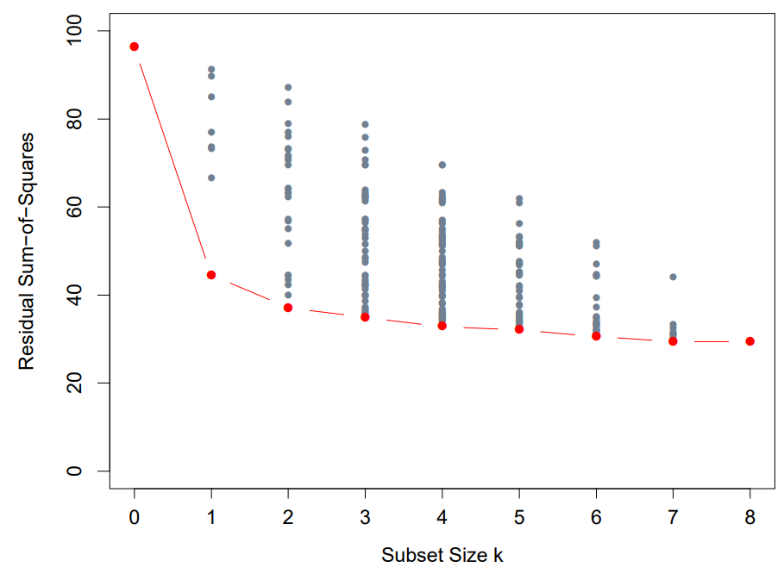
Feature Selection – Best Subset
Choose the k feature set
size you want
Create all subsets of size k
Find the RSS minimization
for your subset

Slide 202
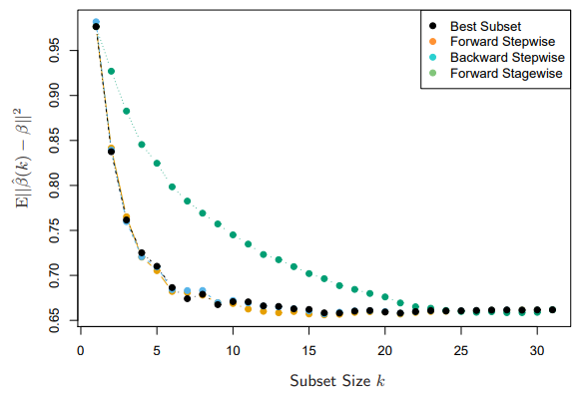
Feature Selection – Stepwise Selection
Forward-stepwise:
Start with an empty model,
add the most predictive
feature, rinse, repeat.
Backward-stepwise:
Start with a full model,
remove the least predictive
feature, rinse, repeat.

Slide 203
Feature Selection – Stagewise Selection
Start with an empty model,
choose the feature that best
correlates to your residual,
update this feature using
the coefficient.

Slide 204

Evaluating Models
Back to it!

